Slide 1

Market Predictors: An analysis of trends in the value of 10yr bonds, gold, Nasdaq and Nikkei
Project Team Daniel Sobral Anthony Elbers Nalishebo Meebelo
This Photo by Unknown Author is licensed under CC BY-SA

Slide 2
Questions that guide the project On Machine Learning How to approach data in a time series with machine learning tools? How can we use these tools for asset value prediction?

Slide 3
Questions that guide the project
On the Data
Is there any uniqueness in analyzing the value of assets than remained relevant for 40 years?
Is there any uniqueness in comparing the value of assets play a major role in the world economy?

Slide 4
Neural Networks - LSTM
The Process

Slide 5
Data Selection
Financial data:
- Debt(U.S. 10 y bonds)
- Equities(nasdaq and nikkei)
- Comoditie(gold)
From 1980 to 2021
Sources:
-- csv format –
Gold -
http://au.investing.com/
All other assets -
http://finance.yahoo.com/

Slide 6
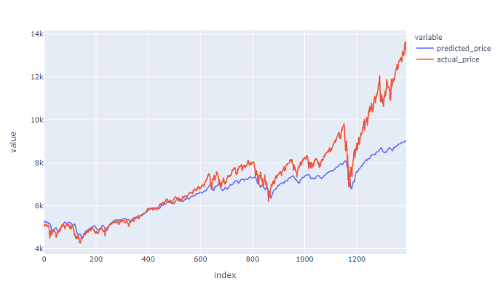
Data Cleaning
Returns offer a measure for comparison. But have extreme daily fluctuations.
While volatility offers more constant values.
Which indicator best suits the model?
In the long run prices generally tend to rise.

Slide 7
The Model
Neural Networks - Long short-term memory model
Respect chronological sequence
Attributes more relevance to more recent data.
Runs through the data in chunks
Requirements
input layer requires 3 dimensions:
samples - groups of data fed to the network
timesteps - length of input sequence
features - features fed per timestep

Slide 8
The Model
Split the Data
Train Data - 2000 to 2017
Test Data - 2017 to 2021
Due to
Extreme global economic differences in previous years.
Further Options
Neural Networks allows us to edit the model through the number of layers, the drop rate after each layer and number of epochs.

Slide 9
The Model
How to score the model
“Accuracy” value not available
Used “loss” and “root mean root mean square error”
Use call back function to avoid overfitting the model

Slide 10
